Slide 1
Dimensional modelling
ASSIGNMENT -1
By
Ankita Patidar
Pranjal Shrivastava
Pranali Kanade

Slide 2
Introduction
We have designed an Entity Relationship Diagram of available stock data that helped us understanding the foundations of dimensional modeling in data warehousing.
We have also designed queries that can further be used as analytical functions like Rollup and Cube for the upcoming assignment.

Slide 3
Dimension and fact tables
Table Name | Table Type | Description
POLITICAL_PARTIES_DIM | Dimensional Table | Yearly snapshot of the type of ruling government
JULIAN_DAYS | Dimensional Table | Description and details of the date condensation.
EOD_STOCK_FACTS | Fact Table | Indicators of price movement for each company’s stock on a given day.
SP500_STOCKS | Dimensional Table | ticker symbol of the company and its details
ENERGY_PRICES | Fact Table | PAIRLINE_STOCKS prices of various fuel types
STOCK_FACTS | Fact Table | Indicators of price movement of the overall Stock Market Index on a given day.
AIRLINE_STOCKS | Dimensional Table | Daily snapshot of airline stocks and its details

Slide 4
Assumptions
● There will be a relationship between energy prices and the stocks and vice-versa. This will be explored during further analysis when analytical queries are framed.
● AIRLINE_STOCKS will be derived from the STOCK model. It gives us better insight and analysis of a particular section of the data.
● The type of ruling parties in the government may be a factor in determining the price of stock. Again, this will be explored during further analysis.
● The daily snapshot of the jet fuel prices under ENERGY_PRICES schema can be used to establish a relation between airline stock prices.

Slide 5
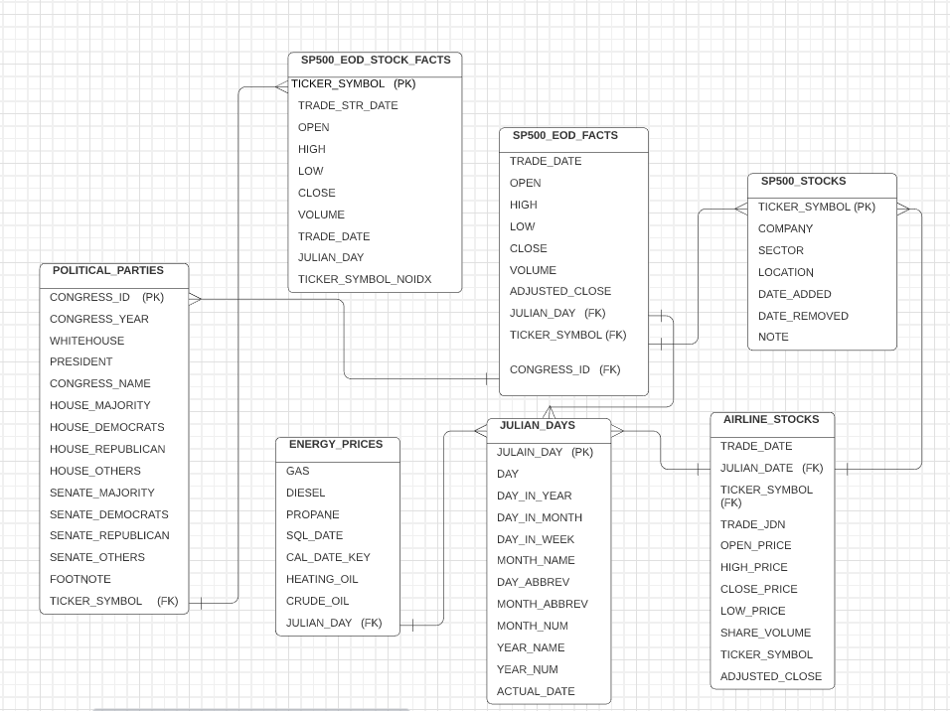
Entity Relationship Diagram

Slide 6
QUERY-1: Average of open and close, max high and min of low, total volume during Single or Divided governments.
SELECT * FROM (( SELECT ‘SINGLE GOVERNMENT’ as gov_type, PPD.WHITEHOUSE_PARTY,PPD.SENATE_MAJOIRTY, PPD.HOUSE_MAJORITY, PPD.CONGREE_YEAR, ROUND(AVG(SEF.OPEN),2) AS OPEN_AVG, MAX(SEF.HIGH) AS MAX_HIGH, MIN(SEF.LOW)
AS MIN_LOW, ROUND(AVG(SEF.CLOSE),2) AS CLOSE_AVG, TO_CHAR(SUM(SEF.VOLUME),'999,999,999,999,999’)
AS TOTAL_VOLUME FROM POLITICAL_PARTIES_DIMS PPD, SP500_EOD_FACTS SEF
WHERE PPD.CONGRESS_ID = SEF.CONGRESS_ID
GROUP BY (PPD.WHITEHOUSE_PARTY,PPD.SENATE_MAJOIRTY, PPD.HOUSE_MAJORITY, PPD.CONGREE_YEAR) HAVING PPD.WHITEHOUSE_PARTY = PPD.SENATE_MAJOIRTY
AND
PPD.SENATE_MAJOIRTY = PPD.HOUSE_MAJORITY) UNION ALL( SELECT ‘DIVIDED GOVERNMENT' as gov_type, PPD.WHITEHOUSE_PARTY,PPD.SENATE_MAJOIRTY, PPD.HOUSE_MAJORITY,PPD.CONGREE_YEAR, ROUND (AVG(SEF.OPEN),2) AS OPEN_AVG, MAX(SEF.HIGH) AS MAX_HIGH, MIN(SEF.LOW)
AS MIN_LOW,ROUND(AVG(SEF.CLOSE),2)
AS CLOSE_AVG, TO_CHAR(SUM(SEF.VOLUME),'999,999,999,999,999') AS TOTAL_VOLUME FROM POLITICAL_PARTIES_DIMS PPD, SP500_EOD_FACTS SEFWHERE PPD.CONGRESS_ID = SEF.CONGRESS_ID
GROUP BY
(PPD.WHITEHOUSE_PARTY,PPD.SENATE_MAJOIRTY, PPD.HOUSE_MAJORITY, PPD.CONGREE_YEAR)HAVING PPD.WHITEHOUSE_PARTY <> PPD.SENATE_MAJOIRTY OR PPD.SENATE_MAJOIRTY <> PPD.HOUSE_MAJORITY
OR
PPD.WHITEHOUSE_PARTY <> PPD.HOUSE_MAJORITY)) ORDER BY CONGREE_YEAR desc;

Slide 7
QUERY-2: Determine the top ten companies which traded maximum volume of stocks till now.
Query:
SELECT SS.company, SEF.ticker_symbol, SUM(SEF.volume)
AS volume FROM SP500_STOCKS SS INNER
JOIN SP500_EOD_FACTS SEF ON SS.ticker_symbol = SEF.ticker_symbol
GROUP BY
SEF.ticker_symbol,SS.company
ORDER BY SUM(SEF.volume)
DESC FETCH FIRST 10 ROWS WITH TIES;

Slide 8
QUERY-3: Yearly periodic snapshot of average of open and close, max high and min of low, total volume of stocks of companies having total volume greater than 60 Million
Query:
SELECT JD.year_num, SS.company, round( AVG(SEF.open), 2)
AS open_avg, MAX(SEF.high) AS max_high, MIN(SEF.low)
AS min_low,round( AVG(SEF.close), 2)
AS close_avg,TO_CHAR( SUM(SEF.volume), '999,999,999,999,999’)
AS total_volume
FROM SP500_EOD_FACTS SEF
JOIN SP500_STOCKS SS ON SEF.ticker_symbol = SS.ticker_symbol JOIN julian_days JD ON JD.julian_day = SEF.julian_day
GROUP BY SS.company,JD.year_num HAVING SUM(SEF.VOLUME) > 60000000ORDER BY JD.year_num DESC,SS.company;

Slide 9
Part b:
We have taken an example of Car Dealership Sales and Services ERD Model.
This ERD has very well-defined relationships with elaborate primary and foreign key defined.
This model can accommodate details of Customer, Salesperson, Mechanic, Services and auto motive's parts.
This model can help understand performance of Salesperson, Mechanic and help understand problematic parts, so that we can better service later.
This model is an example of Services (Mechanical work) and Product Sales (Parts) systems working together to fulfil customer’s requirement.

Slide 10
